Slide 1
PROGRAMMABLE LOGIC CONTROLLER (PLC)
EE 8404
Course Tutor: Eng. Mlay J. J
Assistant Lecturer
(MEng: Power Engineering and Engineering Thermophysics)
joshmlay@gmail.com
Office no: 101A
Department of Electrical and Power Engineering (EPE)
College of Engineering and Technology (CET)
Mbeya University of Science and Technology (MUST)
Mbeya-Tanzania,
2024/2025

Slide 2
PLC’s Programming
Ladder Programming
Conditional Logic
Ladder Diagrams
Outputs and latches
Internal relays
Timers
The Pulse Generator
Counters
PLC’s Ladder Diagram Examples

Slide 3
PLC Connections

Slide 4
Ladder Programming

Slide 5
Conditional Logic
The PLC scans its inputs and, depending on the program, switches on or off various combinations of outputs. The logic state of the output depends on the input conditions; so the term conditional logic is used.
A simple example of conditional logic could be stated as follows:
“A machine switches on if either of two start switches are closed and all of three stop switches are closed.”

Slide 6
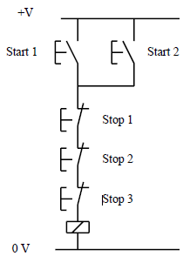
Conditional Logic,,,cont
The conditions could be realized by a hard wire solution as shown,
The two start switches are connected in parallel.
Current will flow if one or the other or both are closed.
The start switches are normally open.
This means that the contacts are apart and no current flows when the switches are in their normal (or unoperated or rest) state.
Machine relay Hard-Wire Conditional Logic Example

Slide 7
Conditional Logic,,,cont
The three stop switches are connected in series.
Current can only flow if the first and the second and the third are closed.
The stop switches are normally closed.
This means that the contacts are connected and current can flow when the switches are in their normal state.
Machine relay Hard-Wire Conditional Logic Example

Slide 8
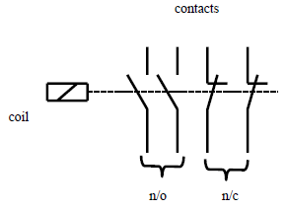
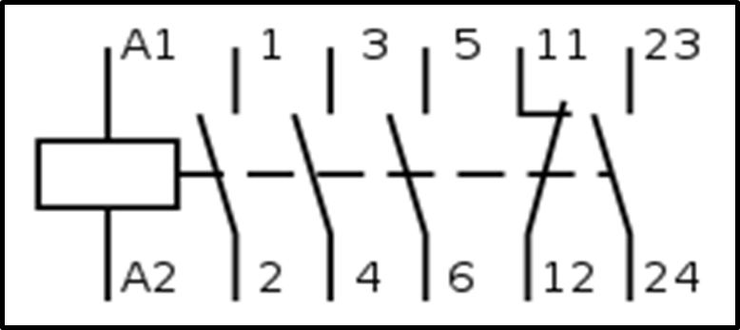
Conditional Logic,,,cont
The relay is a switch with multiple contacts that is operated when its coil is energised.
The contacts are usually capable of carrying a larger current than push- button or limit switches.
Large relays for motor starting are called contactors.
The schematic diagram for a typical relay and contactor is shown
A Relay
A Contactor

Slide 9
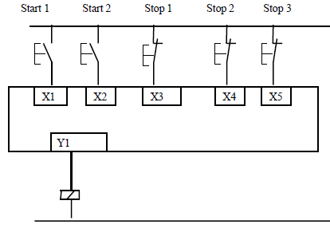
Ladder Diagram,,,cont
To realize the conditional logic statement from the left figure using ladder logic we connect the switches to a PLC as shown On the right figure
Fig 2a Machine relay Hard-Wire Conditional Logic
Fig 2b PLC Wiring Diagram

Slide 10
Ladder Diagram,,,cont
To avoid later confusion regarding the concept of normally open (n/o) and normally closed (n/c) it is worth looking again at Fig 2b and remembering that the plc scans each input and asks “Is it on or is it off?”.
The five switches shown are external devices and the PLC knows nothing about them.
As far as the PLC is concerned, at the moment, inputs X1 and X2 are off and X3, X4 and X5 are on.
Fig 2b PLC Wiring Diagram

Slide 11
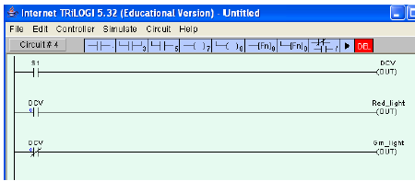
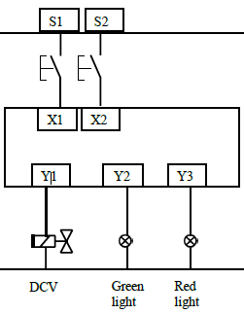
Outputs and Latches
Output states (on or off) can be used in programs as conditions for other actions.
Fig a is the wiring diagram for the program shown in Fig b.
Figure b.
Switching on the input S1 switches on the output DCV which in turn switches on the red light.
When the output DCV is off the green light is on.
Figure a.

Slide 12
Introduction PLC,,,,cont
Example 1
Write a PLC program to implement the conditional logic statements (a), (b) and (c) below.
A PLC output is to switch on if any of three inputs is switched on.
(b) A PLC output is to switch on if any one of three inputs is switched on but not two or more.
(c) A PLC output is to switch on if any two outputs are switched on, but not the third.

Slide 13
Solution 1 (a)

Slide 14
Solution 1 (b)
This program can be read:
“The output switches on if Input 1 is on AND the other two are off, OR input 2 is on AND the other two are off, OR input three is on AND the other two are off.”

Slide 15
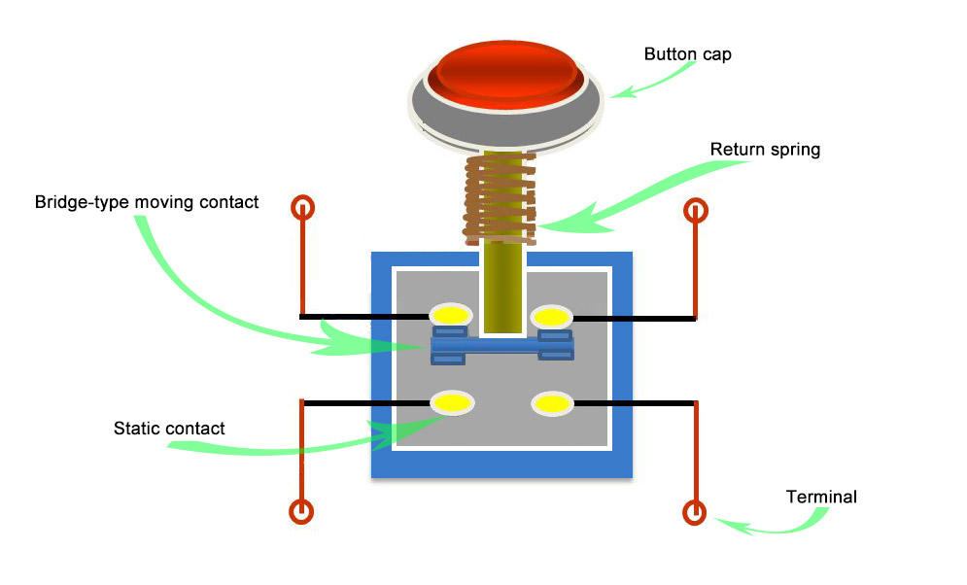
Latches
The push button and limit switches most commonly used in industrial automation are the momentary contact type.
A spring action reverts the switch to the normal state as soon as the button or roller is released.
These are obviously not the same as the self- latching switches used, for example, in domestic circuits.
The fact that the majority of control switches are not self-latching is not as inconvenient as it sounds.
We can easily program in, a latch in the ladder diagram.
NC
NO

Slide 16
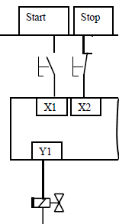
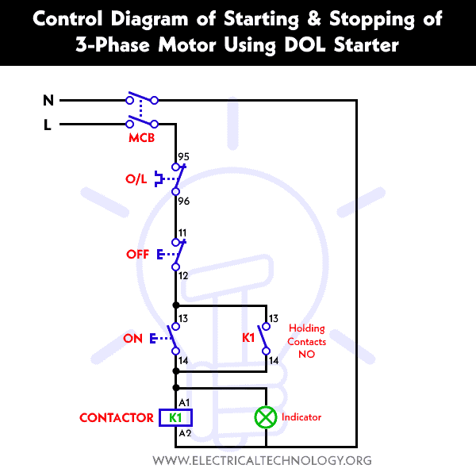
Latches,,,,
Operation: When the start push button switch in is pressed, the output Y1 is to switch on and stay on until the stop button is pressed.
When the output Y1 is energised we use a normally open contact of it in parallel with the start button to hold (or latch) it on.
The output can only be de-energised by pressing of the stop button.
Note that we have used a normally closed switch as a stop button as explained early.

Slide 17
Internal Relays
These have the same properties as outputs but they only exist in software.
They have many uses. Fig below shows an internal relay being used to implement the logic function NAND.
This is the inverse of the result of X1 AND X2. We will be making extensive use if internal relays later.
Note: Most PLCs include a function called a Set and Reset or a flip-flop which latches and delatches an output or an internal relay.

Slide 18
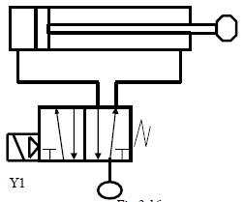
Timers
The delay-on timer introduces a delay between the start of one event and the start of another.
For example, when a start push button is pressed, the pneumatic cylinder shown in Fig 3 extends, remains extended for 5 seconds and then returns.
Draw the PLC wiring diagram and the appropriate ladder logic.
The delay-off timer causes a delay between its input switching off and its contacts reverting to their normal states.
Fig 3

Slide 19
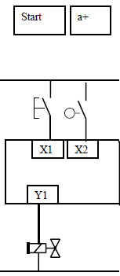
Timers,,,,
The start button and the end-of-stroke limit switch a+ are the PLC inputs and the solenoid Y1 is the output.
Any other components needed for the program can be created in software.

Slide 20
Timers,,,,
Pressing the start button latches on an internal relay called start_latch.
The start_latch relay switches on the output Y1 which energizes the solenoid, and the cylinder extends.
The cylinder rod closes the limit switch a+ which starts the timer in software.
When the timer set value time has elapsed the normally-closed contact Timer_1 in the first line of the program de-energizes the Start_latch relay and the cylinder returns.

Slide 21
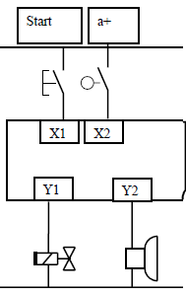
Timers,,,,
Example 2.
We can do another example using the same hardware with the addition of an alarm as a second output:
When the start push button is pressed and released there is a 5s delay before the cylinder extends and returns.
An alarm sounds during the 5s delay.

Slide 22
Timers,,,,
Example 2 soln.
When the start button is pressed the start_latch relay is energised.
The Start_latch relay switches on the timer input and the alarm.
When the timer set value has elapsed the alarm switches off and the solenoid Y1 is energised.
When the cylinder is fully extended the limit switch a+ de-energizes the start_latch relay which de-energizes the solenoid and resets the timer.

Slide 23
Timers,,,,
Note that:
The input to the delay-on timer must remain on for the duration of the timer set value otherwise the timer will not operate.
If the signal to start the timer is only momentary then a latch is used to sustain it.
When the input to the timer switches off, the timer contacts revert immediately to their normal states.

Slide 24
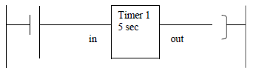
Timers,,,,
In some PLC models a timer function block can be located in the center of a rung as shown in fig below.
When the timer set value has elapsed the timer output switches on allowing a software signal to energize an internal relay coil or an output.
In this course all timer function blocks are located at the right hand side of the ladder diagram and their contacts, normally-open or normally closed, have the same label as the timer.

Slide 25
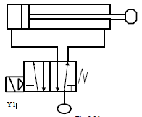
The Pulse Generator
Two counters can be combined to make a pulse generator.
The figure d. below shows the best illustrated by an example.
Fig d

Slide 26
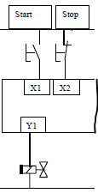
The Pulse Generator
When the Start button in Fig d is pressed the cylinder in Fig f oscillates,
Extending for 2s and
Returning for 1s until the Stop button is pressed.
Write a plc ladder program
Fig f

Slide 27
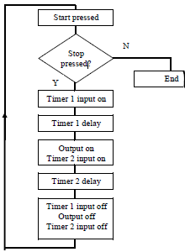
The Pulse Generator
PLC ladder program soln
Figure g. Pulse Generator Flowchart
It can take a while to figure out how the pulse generator works but it is time very well spent. The flow chart in Fig g. should help.

Slide 28
Counters
A counter allows a number of occurrences of input signals to be counted.
The counter is set to a preset number value and when this value of input pulses has been received, it will operate its contacts.
A second input or software coil is provided to reset the current value of the counter to zero.
Consider the cam shaft

Slide 29
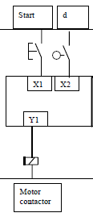
Counters
When a start button has been pressed the shaft is to make 10 revolutions and then stop.
Pressing the start button also resets the counter.
The PLC wiring diagram is shown on the left
The PLC wiring diagram

Slide 30
Counters
The PLC Ladder diagram

Slide 31
PLC’s Ladder Diagram Examples
1. Water level control
The Inlet valve opens when the water level goes to the lower level of the underground tank and gets closed when the underground tank gets full.
The pump starts only when the water level in the overhead tank goes to the lower level of the overhead tank.
The pump stops when the overhead tank gets full or the water level in the underground tank goes to the lower level. I.e. The pump should not dry run.

Slide 32
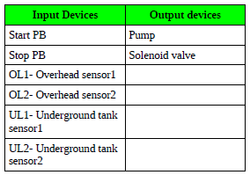
PLC’s Ladder Diagram Examples
1. Water level control; Input and Output devices list

Slide 33
PLC’s Ladder Diagram Examples
1. Water level control SOLUTION

Slide 34
PLC’s Ladder Diagram Examples
2. Milk bottle filling and capping application

Slide 35
PLC’s Ladder Diagram Examples
2. Milk bottle filling and capping application
Start the conveyor in auto mode.
When a bottle present sensor 1 detects the bottle, the conveyor gets stopped and the controller turns on the valve. The milk starts pouring into the bottle up to a certain level, then the valve gets off and the conveyor starts again.
When a bottle present sensor 2 detects the bottle, the conveyor gets stopped, and the capping piston operates, when a cap is detected by a sensor, the capping piston stops and the conveyor starts again.
When a bottle present sensor 3 detects the bottle, the conveyor gets stopped, and the labeling piston operates, when a label is detected by a sensor, the labeling piston stops and the conveyor starts again.
This cycle continues until a stop PB is pressed.

Slide 36

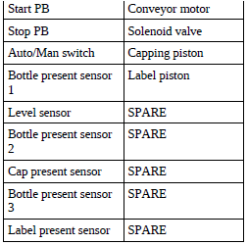
PLC’s Ladder Diagram Examples
2. Milk bottle filling and capping application Input and Output devices list

Slide 37
PLC’s Ladder Diagram Examples
2. Milk bottle filling and capping application solution

